Slide 1
Restaurant for Washington county
Ibm data science capstone project

Slide 2

Problem statement
Restaurant to be of a type county people are familiar with
Restaurant to be located within area of heavy restaurant traffic
Restaurant to be located within area of heavy shoppers traffic
Restaurant to be of the type that’s least common in area of location

Slide 3

data
Information about county’s cities and their location coordinates from https://simplemaps.com
Information about food and shopping venues from https://developer.foursquare.com/

Slide 4
methodology
Clean
Clean dataset obtained from simplemaps
Create
Create developers account with API access at Foursquare
Use
Use Geopy library to obtain coordinates of Washington county
Superimpose
Superimpose cities on it using coordinates obtained from dataset

Slide 5
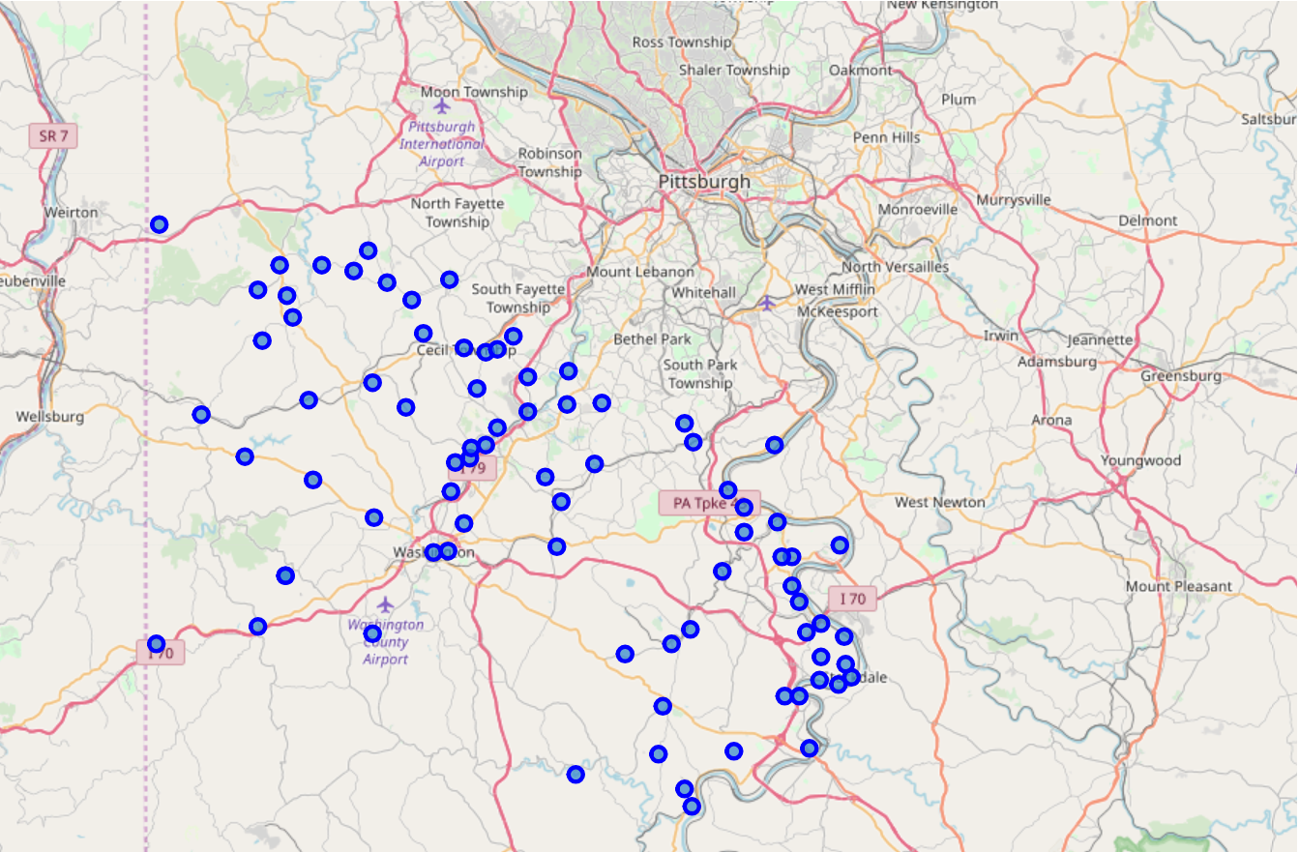
methodology
Map of Washington county with cities superimposed

Slide 6
methodolody
Obtain
Obtain food venues from foursquare in cities of Washington county
Drop out
Drop out cities without food venues
Rank
Rank least common food venues for each city
Run
Run K means clustering ML algorithm to group cities to 8 clusters
Find
Find cluster with maximum concentration of cities and food venues

Slide 7
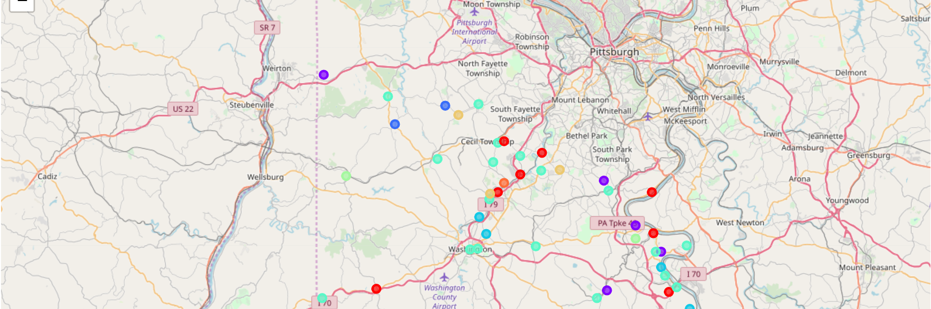
methodology
8 clusters of cities according to frequency of food venues superimposed on Washington County Map

Slide 8
Methodology
Obtain
Obtain shopping centers from foursquare in cities of Washington county
Drop out
Drop out cities without shopping centers
Rank
Rank most common shopping centers for each city
Keep
Keep the top 10 most frequent shopping centers for each city
Run
Run K means clustering ML algorithm to group cities to 8 clusters
Find
Find cluster with maximum concentration of cities and shopping centers

Slide 9
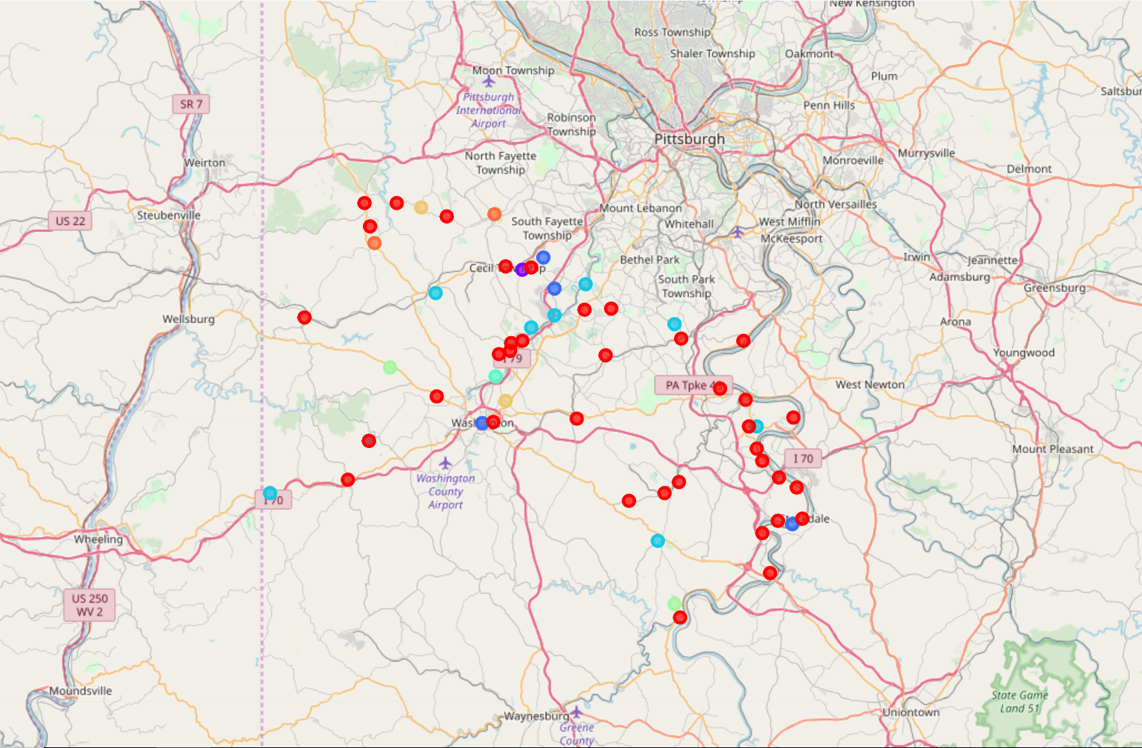
methodology
8 clusters of cities according to frequency of shopping centers superimposed on Washington County MaP

Slide 10
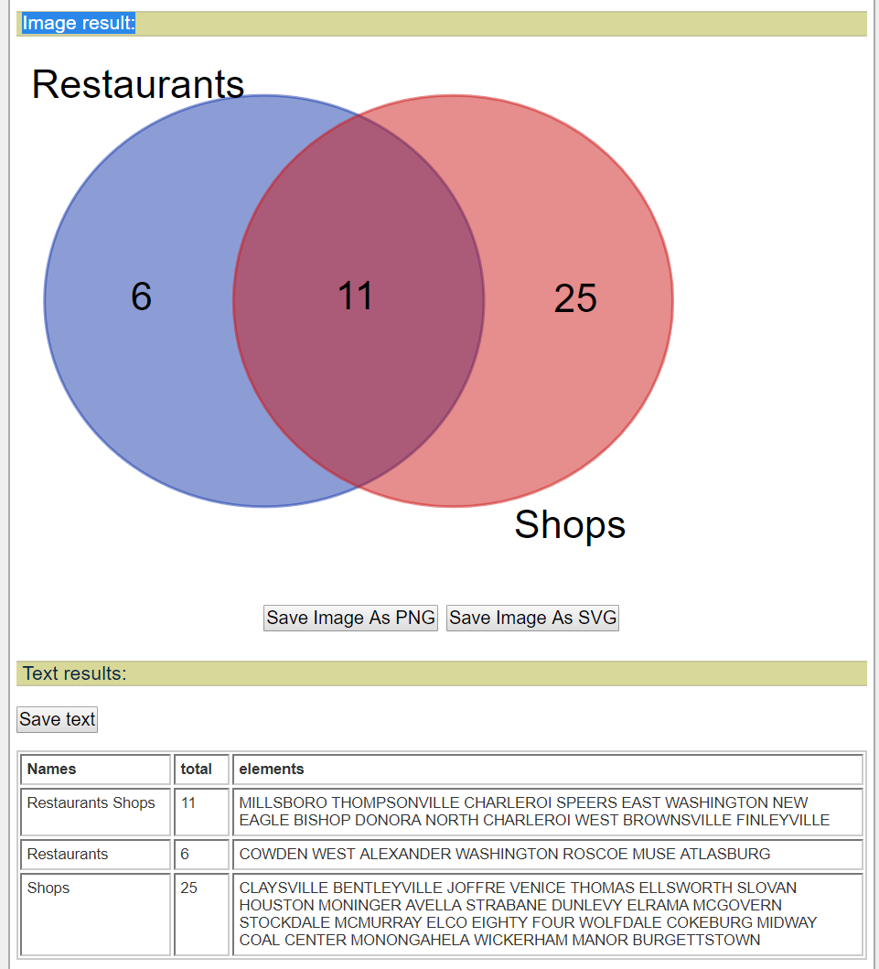
methodology
Find cities at the intersection of food venues and shopping centers clusters

Slide 11
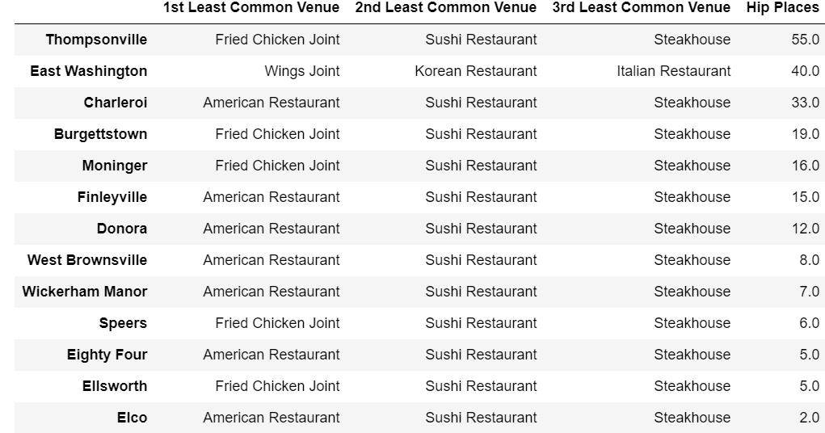
methodology
RANK THE CITIES ACCORDING TO HIGHEST NUMBER OF RESTAURANTS AND SHOPPING PLACES
FIND THE LEAST COMMON FOOD VENUE AT THE TOP CITY

Slide 12
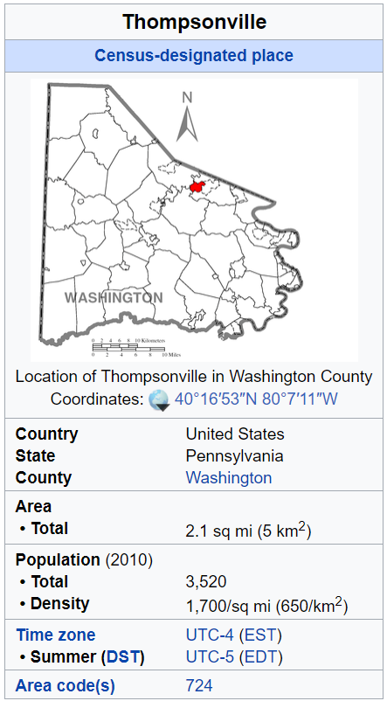
RESULTS
RESTAURANT TO BE LOCATED AT THOMPSONVILLE CITY

Slide 13
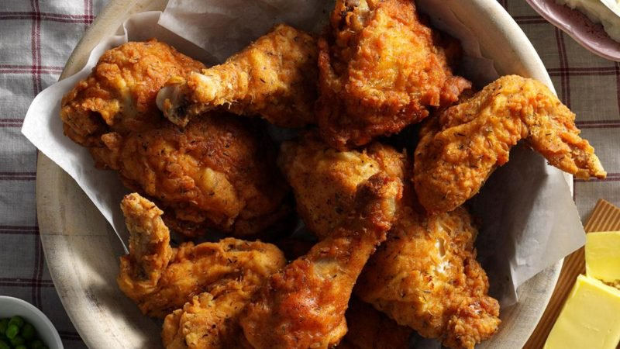
CONCLUSION
GOODRICH’S FRIED CHICKEN JOINT

